Slide 1
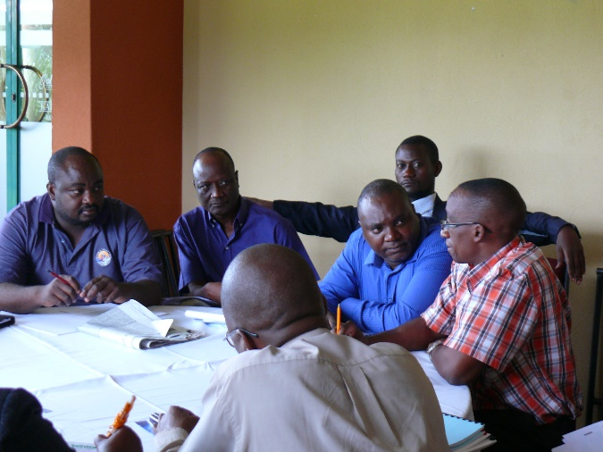
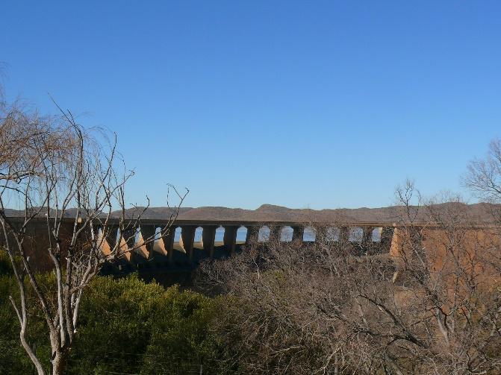
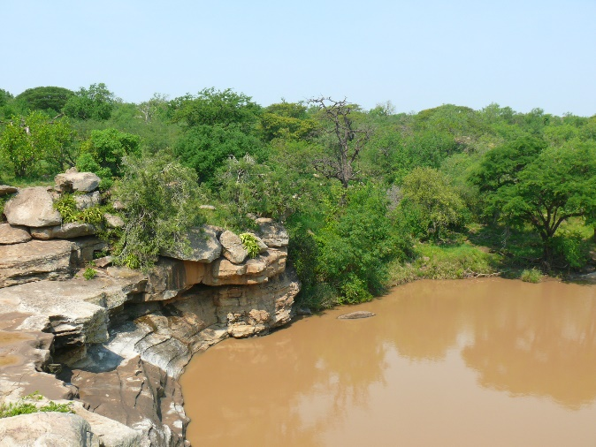
River Basin Management in Southern Africa
Barbara Schreiner

Slide 2
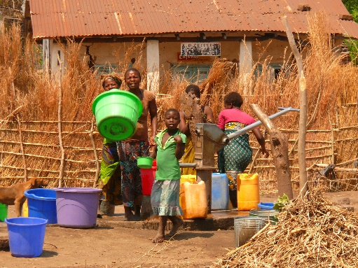
Contents
Context
SADC Institutional Arrangements
Orasecom Plan
Lessons Learned

Slide 3
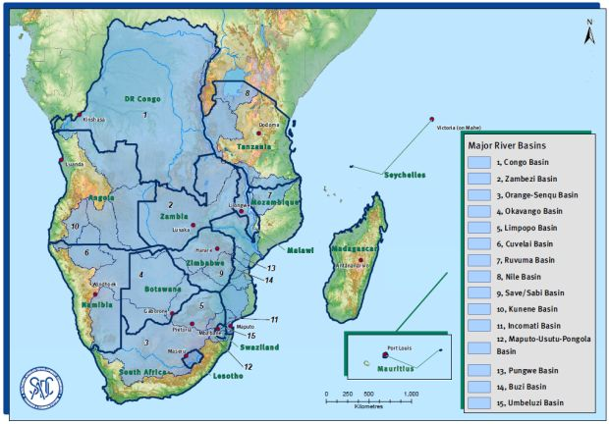
Southern African Basins

Slide 4
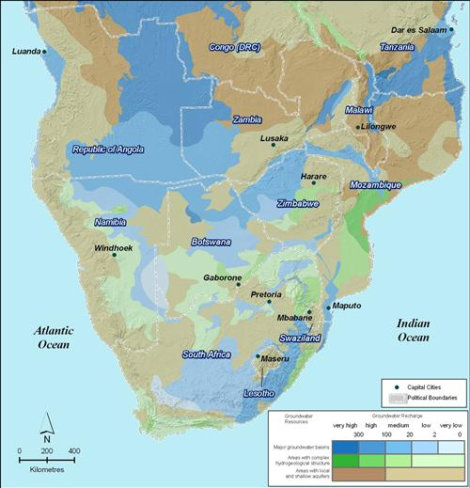
Southern Africa Aquifers

Slide 5
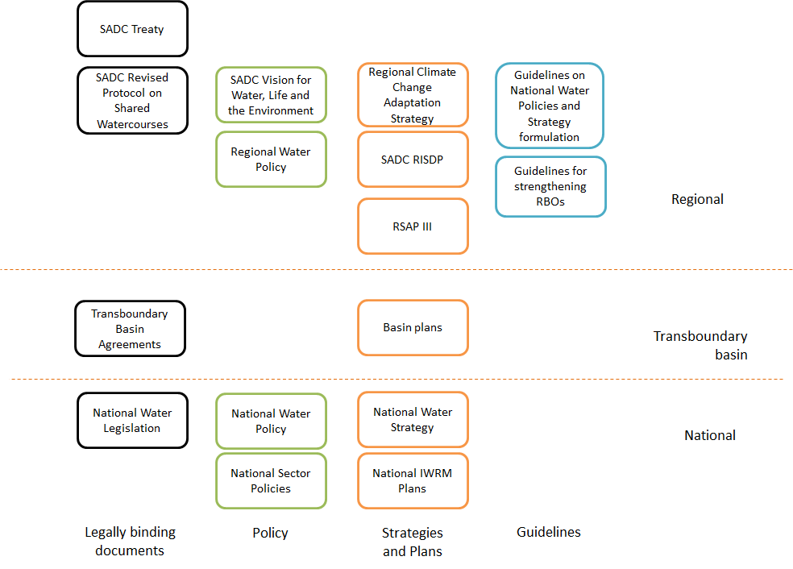
Institutional arrangements
Aligned with UN Convention
Sets framework for all transboundary basin agreements in the region
Basin wide agreements in most basins;
Bilateral agreements general point of practical engagement
Weak on groundwater and water quality
No tribunal to settle disputes

Slide 6
Institutional arrangements
Basin plans developed for several basins
Implementation is through national government (or through River Basin Authorities)

Slide 7
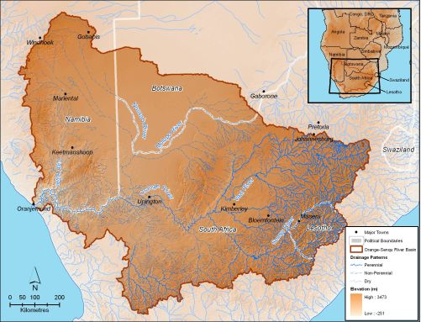
Orange-Senqu River Basin

Slide 8
Orasecom
Orange-Senqu Basin Commission (South Africa, Botswana, Lesotho, Namibia)
Council
Technical advisor to Parties re development, utilisation and conservation of water resources
Delegations from each of the four member states
Secretariat
Hosted by South Africa
Role in programme coordination and management including :
Coordinate ORASECOM activities and implement ORASECOM decisions
Serve as a repository of information re Orange-Senqu River basin
Act as a focal point for ORASECOM with external parties
Perform ORASECOM administrative functions
Conduct communication and promotion for ORASECOM
Programme and project development and management
Resource mobilisation
Technical Task Teams
Established by Council with representatives from member states
Communications, Financial, Legal, Technical (including a hydrogeology committee).

Slide 9
Orasecom Basin Planning
Orange-Senqu River Basin-Wide Integrated Water Resources Management Plan divided into three phases:
Phase I: 2004 - 2007,
collating existing information on water resources of basin eg hydrology, water resource availability; economics and current use of economic tools in water resource management and allocation; demographics, water demand, and water resources development in the basin; water infrastructure in the basin; policy, legal and institutional frameworks related to water resources management in the basin; water quality and pollution; ground water availability and use; and environmental considerations.
Phase II: 2009 – 2011:
bridging planning gaps identified in Phase I
(i) Assessment and upgrading of Integrated Orange-Senqu River Basin Model;
(ii) Updating and extension of hydrology;
(iii) Assessment of requirements for, and development of, an Integrated Water Resources Quality Management Plan;
(iv) Assessment of impact of climate change on hydro-climatology, water resources, vulnerabilities and adaptation requirements;
(v) Assessment of environmental flow requirements; and
Other studies completed as building blocks towards Basin-wide IWRM Plan
Phase III: 2014: Consolidation of work done to date
actions necessary to achieve the strategic objectives of ORASECOM
transition from planning to implementation of the actions that are determined in the Plan.

Slide 10
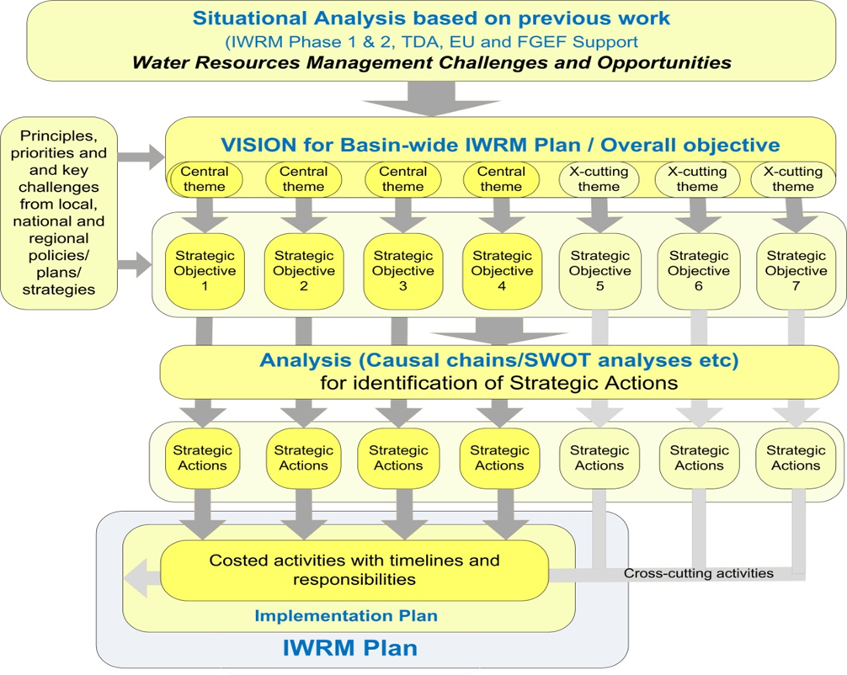

Slide 11
Basin Vision
IWRM Plan been on ORASECOM’s agenda for many years
But vision of IWRM for the basin has remained absent
necessary to provide direction for IWRM Plan
visioning exercise carried out in October 2013:

Slide 12
Basin Vision
A well-managed water secure basin with prosperous inhabitants living in harmony in a healthy environment
Central objectives:
Ensure optimised sustainable management of basins’ water resources
Support socio-economic upliftment and eradication of poverty in basin
Ensure adverse effects of catchment degradation are reduced and sustainability of resource use is improved
Maximise security from water-related disasters (especially flood and drought)
Enabling strategic objectives: (to support realisation of central objectives):
Put adequate knowledge base in place,
Build sufficient capacity and institutional strength,
Promote high level of stakeholder engagement
Ensure appropriate financing mechanisms are in place,
Promote adaptive management and effective monitoring and evaluation systems.
Cross-cutting strategic objectives:
Promote main-streaming of adaptation to climate change into planned actions
Ensure main-streaming of gender considerations into planned actions

Slide 13
Some theory.. Some lessons..

Slide 14
Some lessons…
Building trust between basin states takes time
Reliable and shared information is a critical part of building trust
Learn by doing
Match plan to available resources and to context

Slide 15
Evolution of Basin Management and Planning
Demand Management
Water Use
Infrastructure Refurbishment
Infrastructure Investment
Infrastructure development
Water Management Investment
Water Availability
Water Quality Management
Public infrastructure financing
Mixed management financing
Increasing complexity

Slide 16
10 Rules of Basin Planning
Develop comprehensive understanding of entire system
Plan and act even without full knowledge
Prioritise issues for current attention and adopt phased approach to achievement of long-term goals
Enable adaptation to changing circumstances
Accept that basin planning is inherently iterative and chaotic

Slide 17
10 Rules of Basin Planning
Develop relevant and consistent thematic plans
Address issues at the appropriate scale by nesting plans under the basin plan
Engage stakeholders with a view to strengthening institutional relationships
Focus on implementation throughout
Select the planning approach and methods to suit the basin needs

Slide 18
